Slide 1
Anote Frontend Challenge
Cornell Tech Intern Search Application

Slide 2
How to run the application
npm start
To run the app in the development mode. Open [http://localhost:3000] to view in your browser.
npx json-server -p 3001 db.json
To run the server side of the application

Slide 3
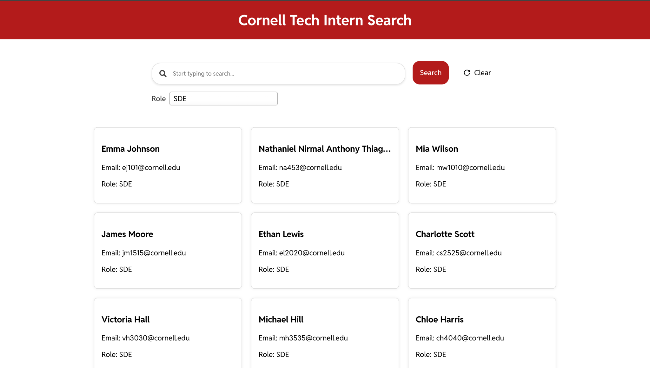
User Interface
The user interface of application is displayed, which is in the colors of the Cornell Tech. The interface shows the candidate list in the form of cards containing the data of the students. The app also consists of search bar, filter drop-down, search button and a clear button. The features of the are discussed in the further slides.

Slide 4
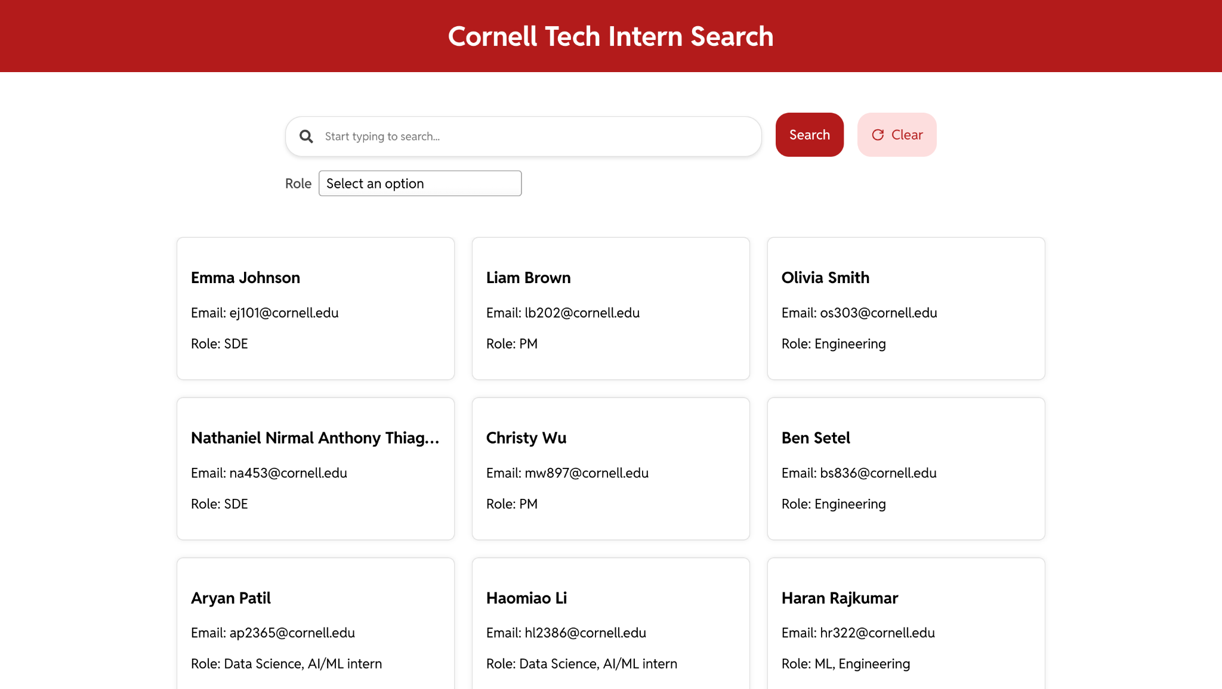
Effects
Effects like the highlighting of the clear button when the cursor hovers over it and the display of loading state when the data is being fetched are present in the app. The adjoining screenshot shows one of the effects.

Slide 5
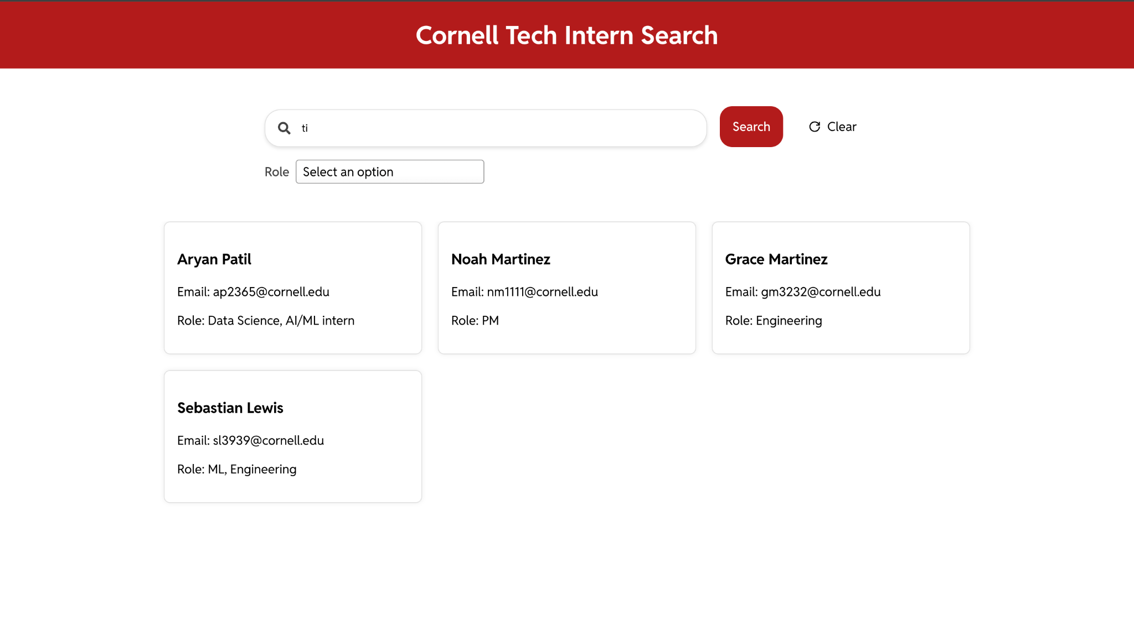
Search functionality
Search functionality is shown in the adjoining screenshot. When a phrase is entered in the search component and search button is clicked then the search functionality enables the display of the student cards whose name contains the given phrase.

Slide 6
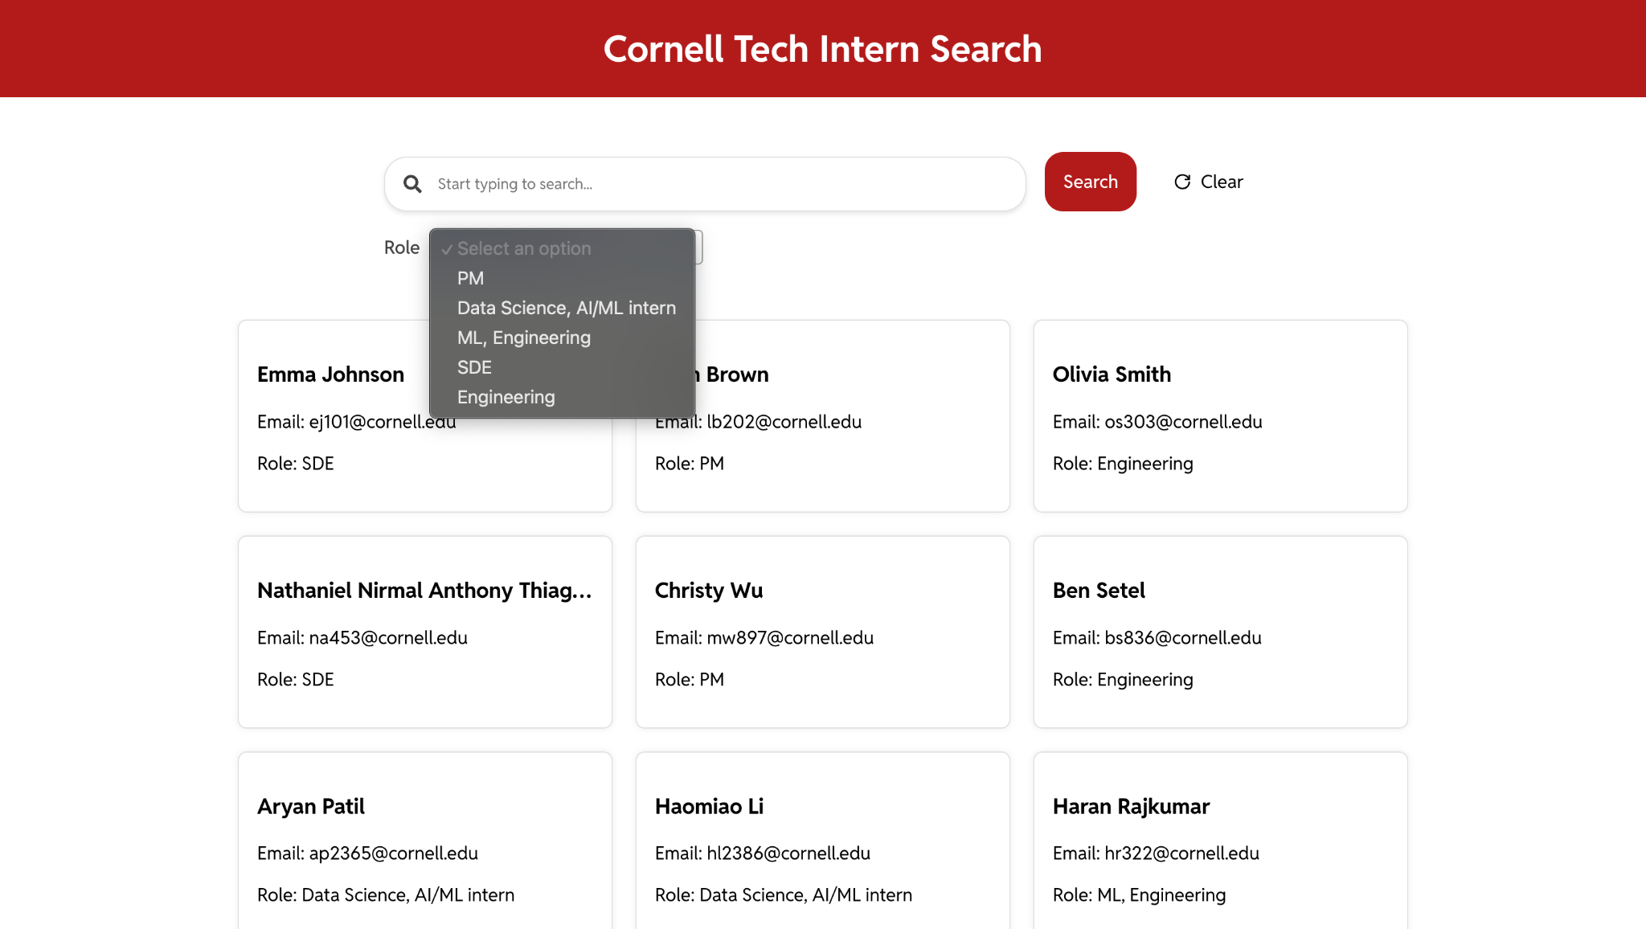
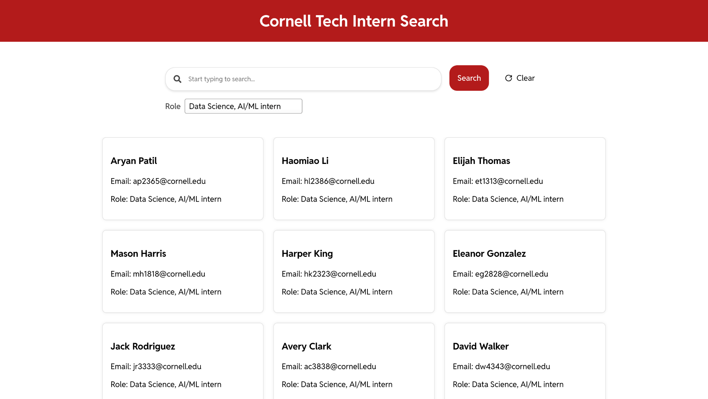
Filters
Filters allow the user to filter according to the skillsets of students (SDE, ML, PM…)
In the top image, drop down list is displayed from which the user can select the filter to be applied and the bottom image shows the results when a filter is applied. By expanding this feature, better and more sophisticated filters can be implemented in the same manner.

Slide 7
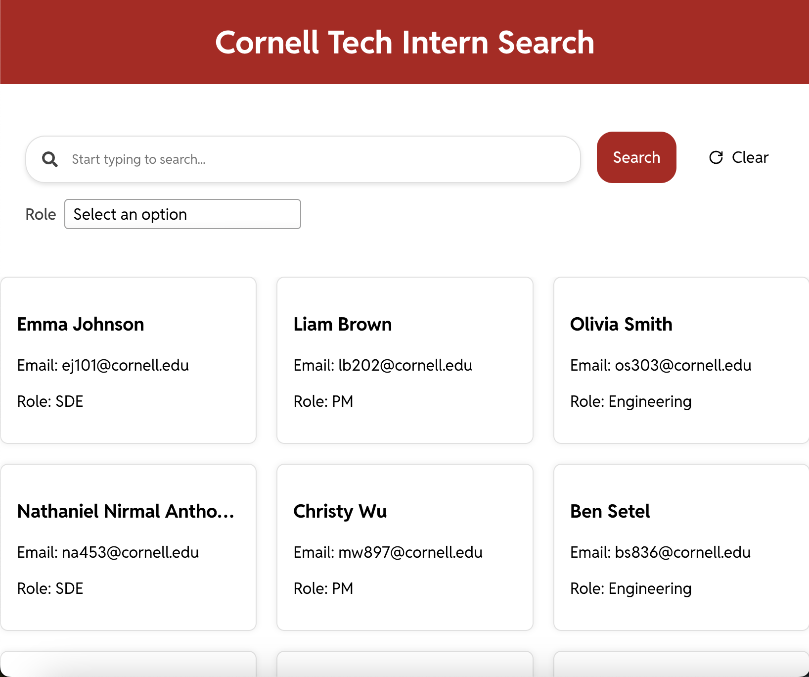
Styling and Responsiveness
The design is styled to look catchy, attractive and at the same time serve an easy to use experience to the user. The application has a responsive design, therefore it is visible properly on a smartphone, tablet and a desktop.

Slide 8
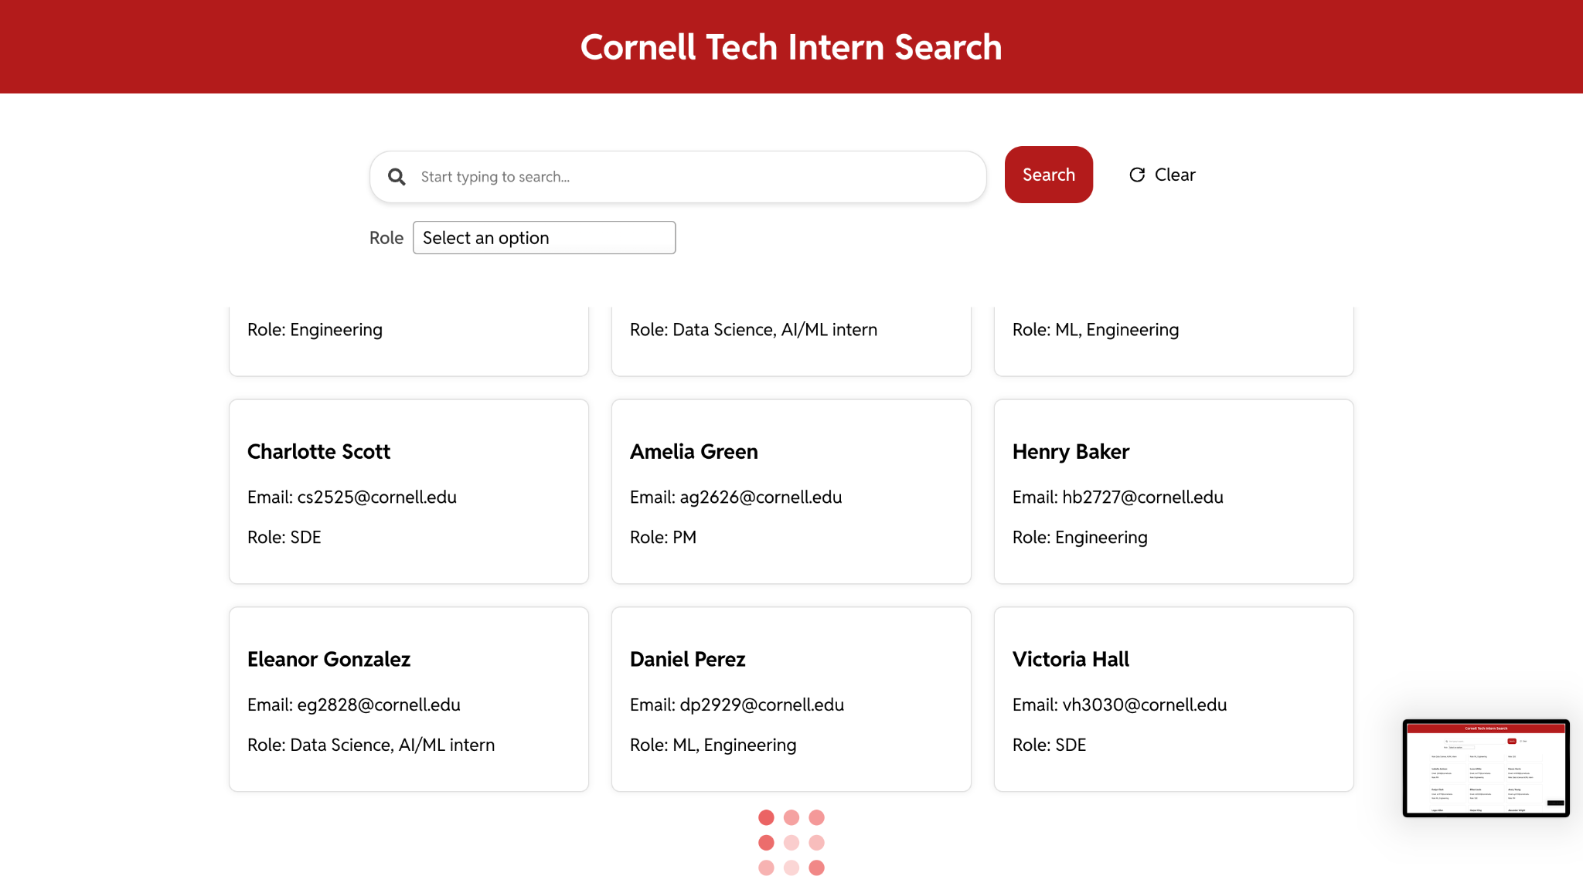
Pagination and Infinite Scrolling
The application incorporates pagination by dividing data into pages and infinite scrolling is implemented. In order to emulate data transfer from the server to the client (delay), loading effect is displayed at the end of a page while scrolling until further data is fetched.

